Slide 1
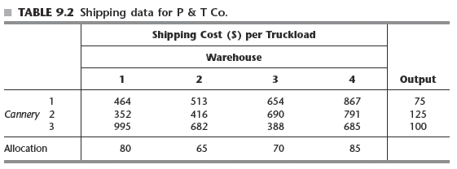
P&T Shipping Problem
How to minimize total shipping cost?
Notes:
Solving the P&T Co. example using a spreadsheet
See Figure 9.4 in the text
Solver uses the general simplex method
Rather than the streamlined version specifically designed for the transportation problem

Slide 2
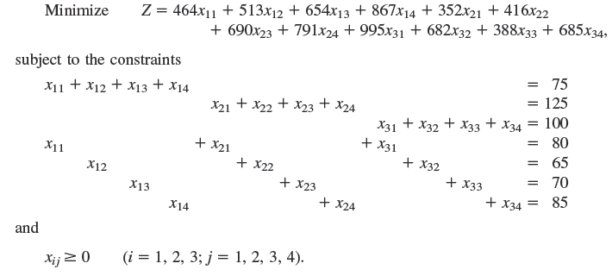
Mathematical Programming
Z: total shipping cost
x_{ij} : number of truckloads shipped from cannery i to warehouse j

